Slide 1
Modeling Batter Swing Probability Using MLB Statcast Data
By Cade Thompson
May 2025

Slide 2

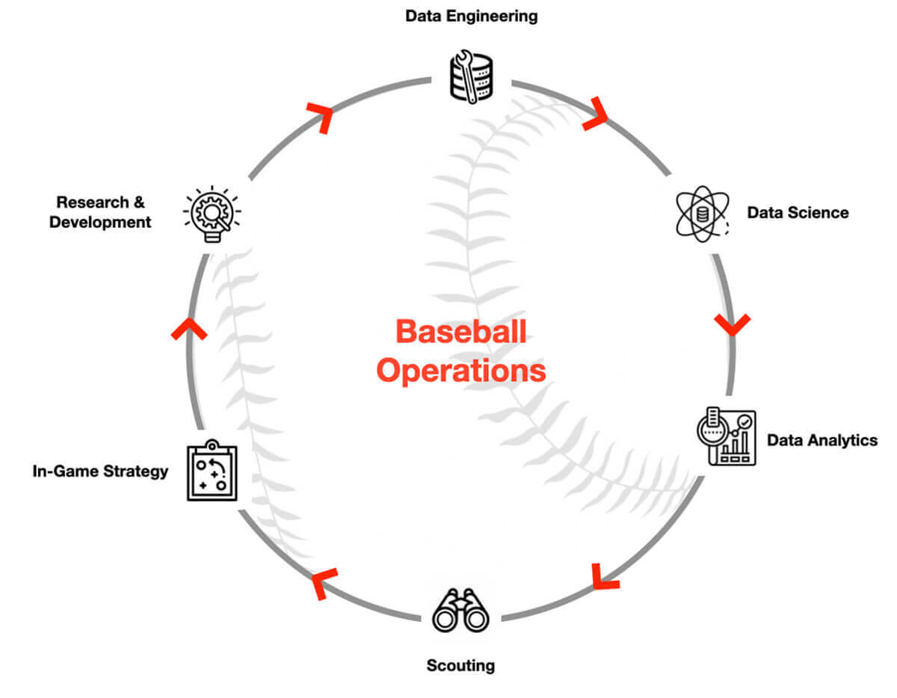
Baseball Analytics - Statcast
A Shift towards Data Analytics with the development of statcast in the MLB
Baseball has been broken down into a science in recent years with teams of data engineers to handle and analyze vast amounts of data
Statcast is a player and ball tracking system in MLB that records pitch, hit, and fielding data using radar and camera technologies.
Statcast tracks detailed in-game data, including:
Pitch velocity and spin rate
Pitch location (horizontal and vertical)
Exit velocity and launch angle of batted balls
Player movements (e.g., sprint speed, reaction time)
Fielding metrics like catch probability and route efficiency

Slide 3
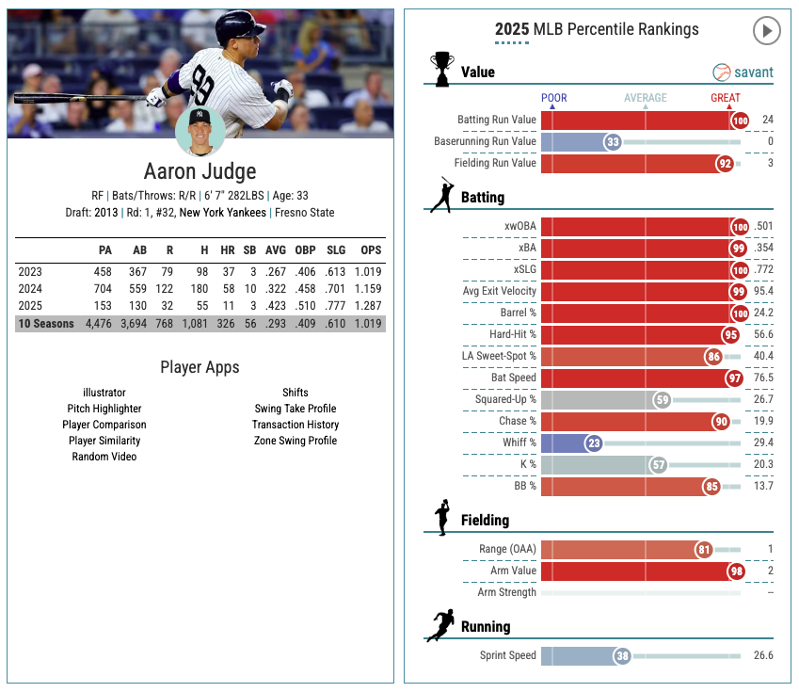
Project Goal
Models the probability that a batter – Aaron Judge - swings at any given pitch using Statcast data, based on physical pitch characteristics such as speed, spin rate, and location.

Slide 4
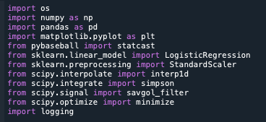
Python Tools and Libraries
pybaseball – Used to pull raw Statcast data directly from MLB
pandas, numpy – Data cleaning, transformation, and numerical computation
matplotlib, plotly – For plotting swing probabilities and heatmaps
scikit-learn – Logistic regression modeling and feature scaling
scipy – Used for interpolation (interp1d), integration (simpson), optimization (minimize), and smoothing (savgol_filter)
logging – To monitor code execution and assist with debugging

Slide 5
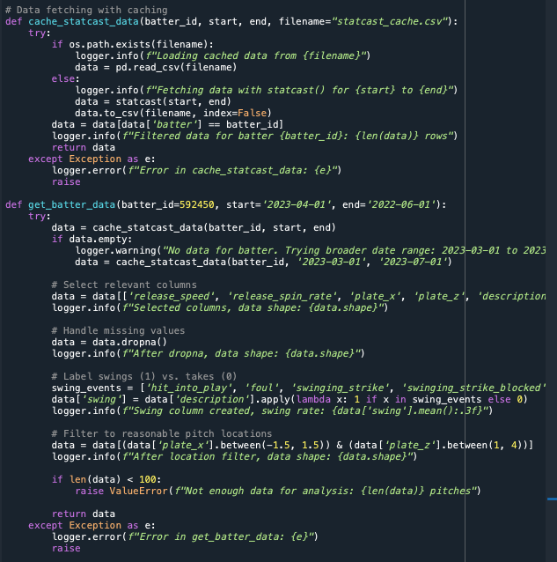
Data Collection – Pybaseball, Caching and Filtering
Fetch 2023 MLB Statcast data for Aaron Judge (ID: 592450) using pybaseball.
pybaseball.statcast(start, end) retrieves pitch metrics (e.g., speed, location).
Caching: Stored in statcast_cache.csv to avoid repeated API calls, speeding up analysis.
Filter data: Remove rows with missing values using dropna, label swings (1/0) based on events (e.g., ‘hit_into_play’), and restrict pitch locations to strike zone (-1.5 to 1.5 for x, 1 to 4 for z).

Slide 6
Swing Probability vs Release Speed
Model Training
Data Training
Train a logistic regression model on pitch data (speed, spin rate, plate x, plate z) to predict swing probability.
Standardize features to ensure fair comparison across variables.
Numerical Methods for Probabilities
Predict swing probabilities for each pitch using the trained model.
Group pitches by release speed and compute average swing probability per speed.
Smooth the data with a rolling average to reduce noise.
Interpolate using linear interpolation to create a continuous curve over 500 points (75-100 mph).
Optimization
Apply numerical optimization to find the speed that minimizes swing probability.
Use a minimization algorithm with bounds set to the speed range (75-100 mph).
Probability Prediction
Smoothing/ Interpolation
Optimization

Slide 7
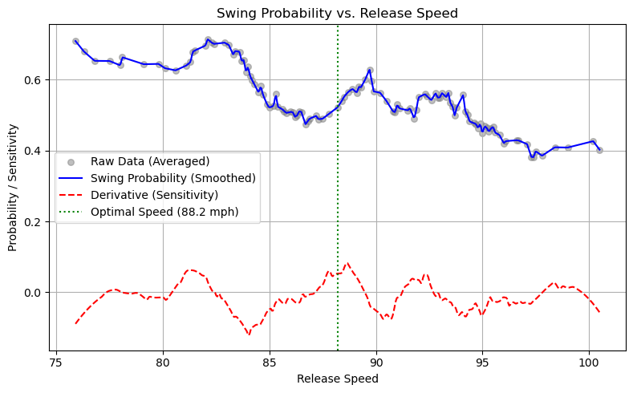

Slide 8
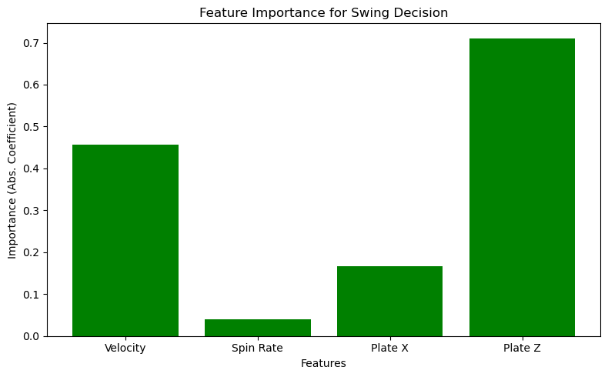
Feature Importance
LogisticRegression (sklearn): Fits the model to predict swings; coefficients reveal feature importance.
np.abs: Computes absolute value of coefficients to quantify importance (e.g., Plate Z: 0.711).
How Graph is Created
Train a logistic regression model on pitch features (release speed, spin rate, plate x, plate z).
Extract importance from model coefficients to measure influence on swing decisions.
Plot importance values as a bar chart for each feature.
Importance
Highlights Plate Z (vertical location) as the key driver of swing decisions.
Suggests pitchers focus on pitch height, akin to prioritizing a control variable.

Slide 9
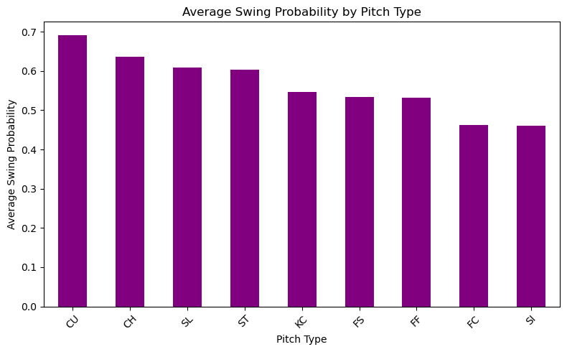
Swing Probability by Pitch Type
pandas.groupby & agg: Groups pitches by type and computes average swing probability.
predict_proba (sklearn): Predicts swing probabilities from the logistic regression model.
How Graph is Created
Predict swing probabilities for all pitches using the trained logistic regression model.
Group pitches by their type (e.g., fastball, slider) and calculate the average swing probability.
Plot the average probabilities as a bar chart for each pitch type.
Importance
Reveals which pitches Judge swings at more (e.g., fastballs over sliders).
Helps pitchers select pitch types to reduce swings, like choosing a catalyst.

Slide 10
Summary of Numerical Methods Used
Logistic Regression for Probability Prediction:
Fits a model to predict swing probability based on features (speed, spin, location).
Standardizes features for fair comparison; coefficients reveal feature importance (e.g., Plate Z: 0.711).
Rolling Average and Interpolation (Swing Probability vs. Release Speed):
Smooths noisy probability data with a rolling average (window size: ~10% of data).
Interpolates using linear interpolation to create a continuous curve over 500 points (75-100 mph).
Numerical Optimization (Optimal Speed):
Uses a minimization algorithm to find the speed (88.2 mph) that minimizes swing probability.
Applies bounds (75-100 mph) to ensure practical results, leveraging data density at 85-90 mph.
Numerical Integration (Expected Swings):
Integrates swing probabilities over the strike zone (plate x: -1.5 to 1.5, plate z: 1 to 4) using Simpson’s rule.
Computes expected swings (0.587) by averaging over the zone’s area.
Averaging for Swing Rate:
Calculates the mean of swing labels (1 for swing, 0 for take) to get the swing rate (54.8%).

Slide 11
Conclusion
Feature Importance revealed Plate Z as the dominant factor at 0.711, underscoring that vertical pitch location significantly influences Judge’s swing decisions, guiding pitchers to prioritize height variation.
Optimal release speed of 88.2 mph, identified through numerical optimization, minimizes swing probability, aligning with changeup speeds and offering a practical strategy to reduce swings.
Swing rate of 54.8% and expected swings of 0.587 per pitch, derived from data averaging and numerical integration, establish a reliable baseline for understanding Judge’s swing tendencies.
Future Work
Enhance the model by incorporating situational game context, such as ball-strike count, inning, or runner positions, to better capture how external factors influence swing probability in real-game scenarios.
Apply the methodology to a broader set of batters, enabling the development of pitcher-specific strategies tailored to individual matchups, thus improving overall pitching performance across diverse opponents.

